Slide 1
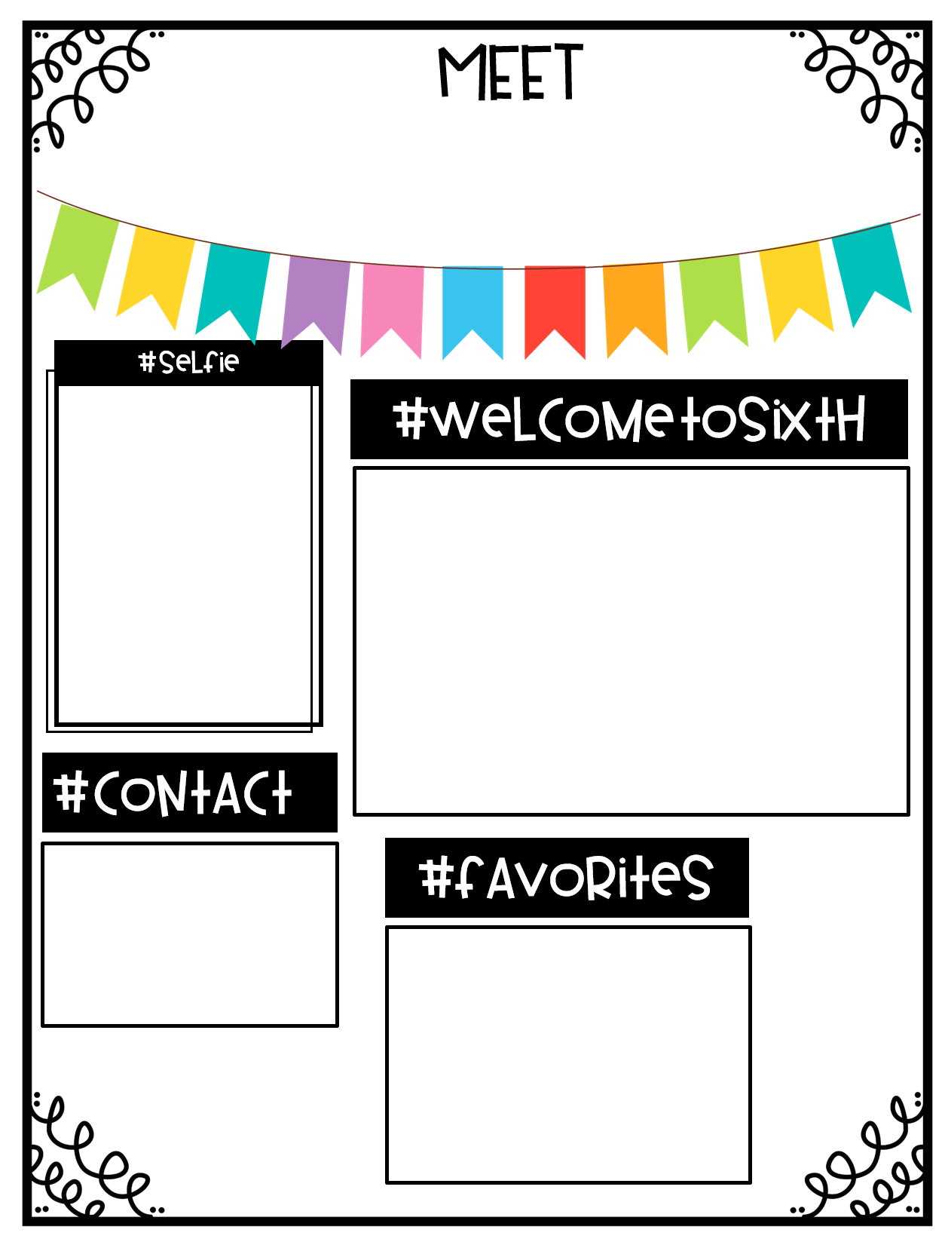
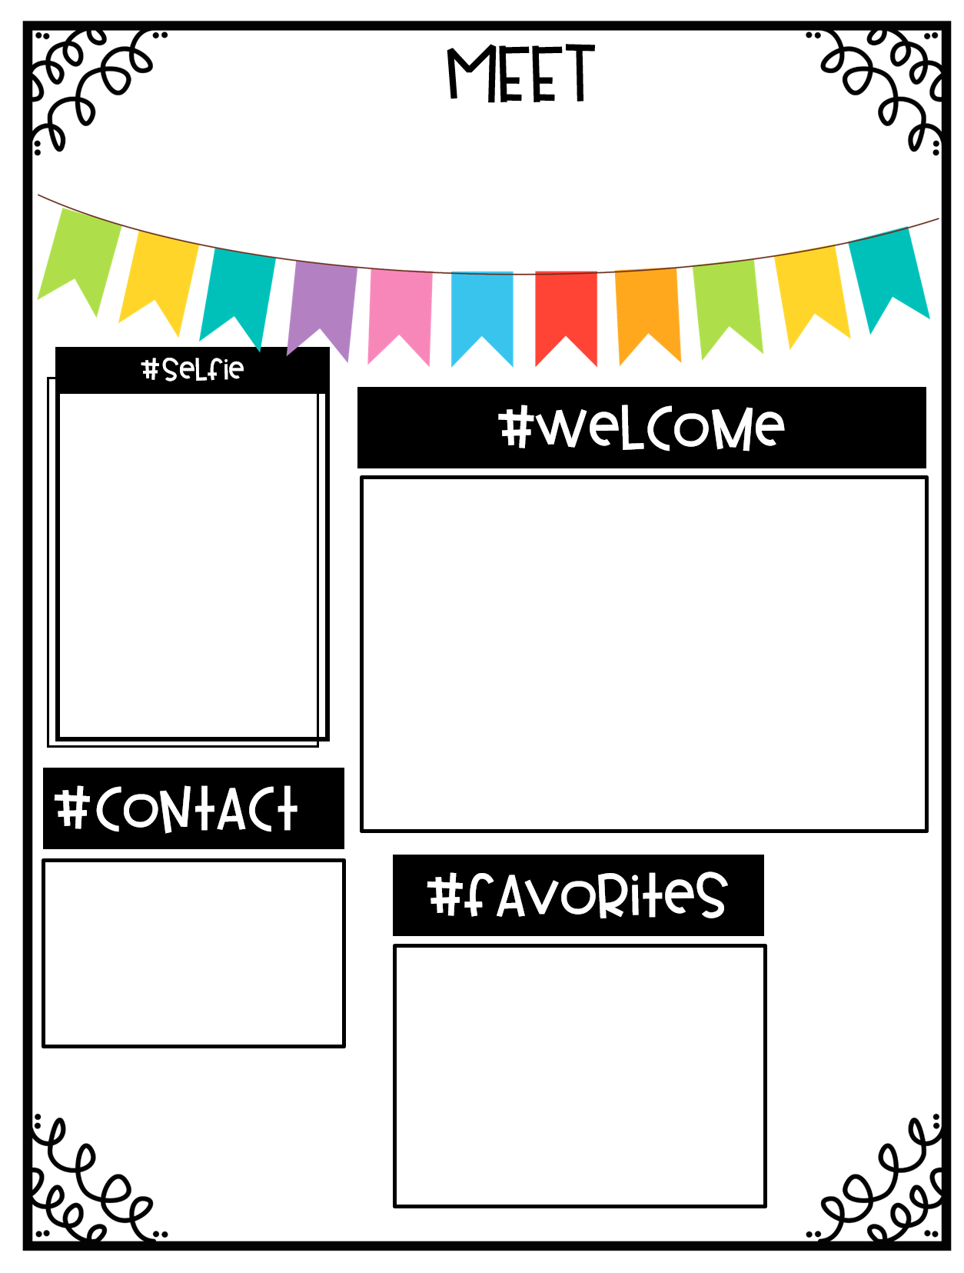
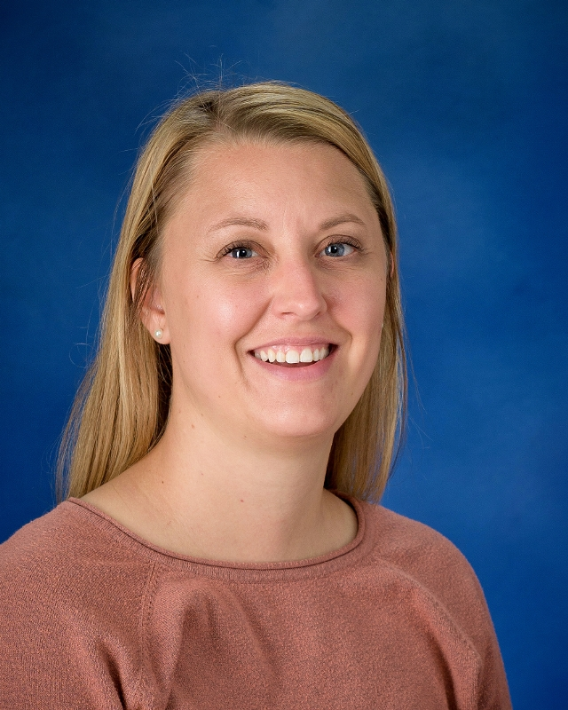
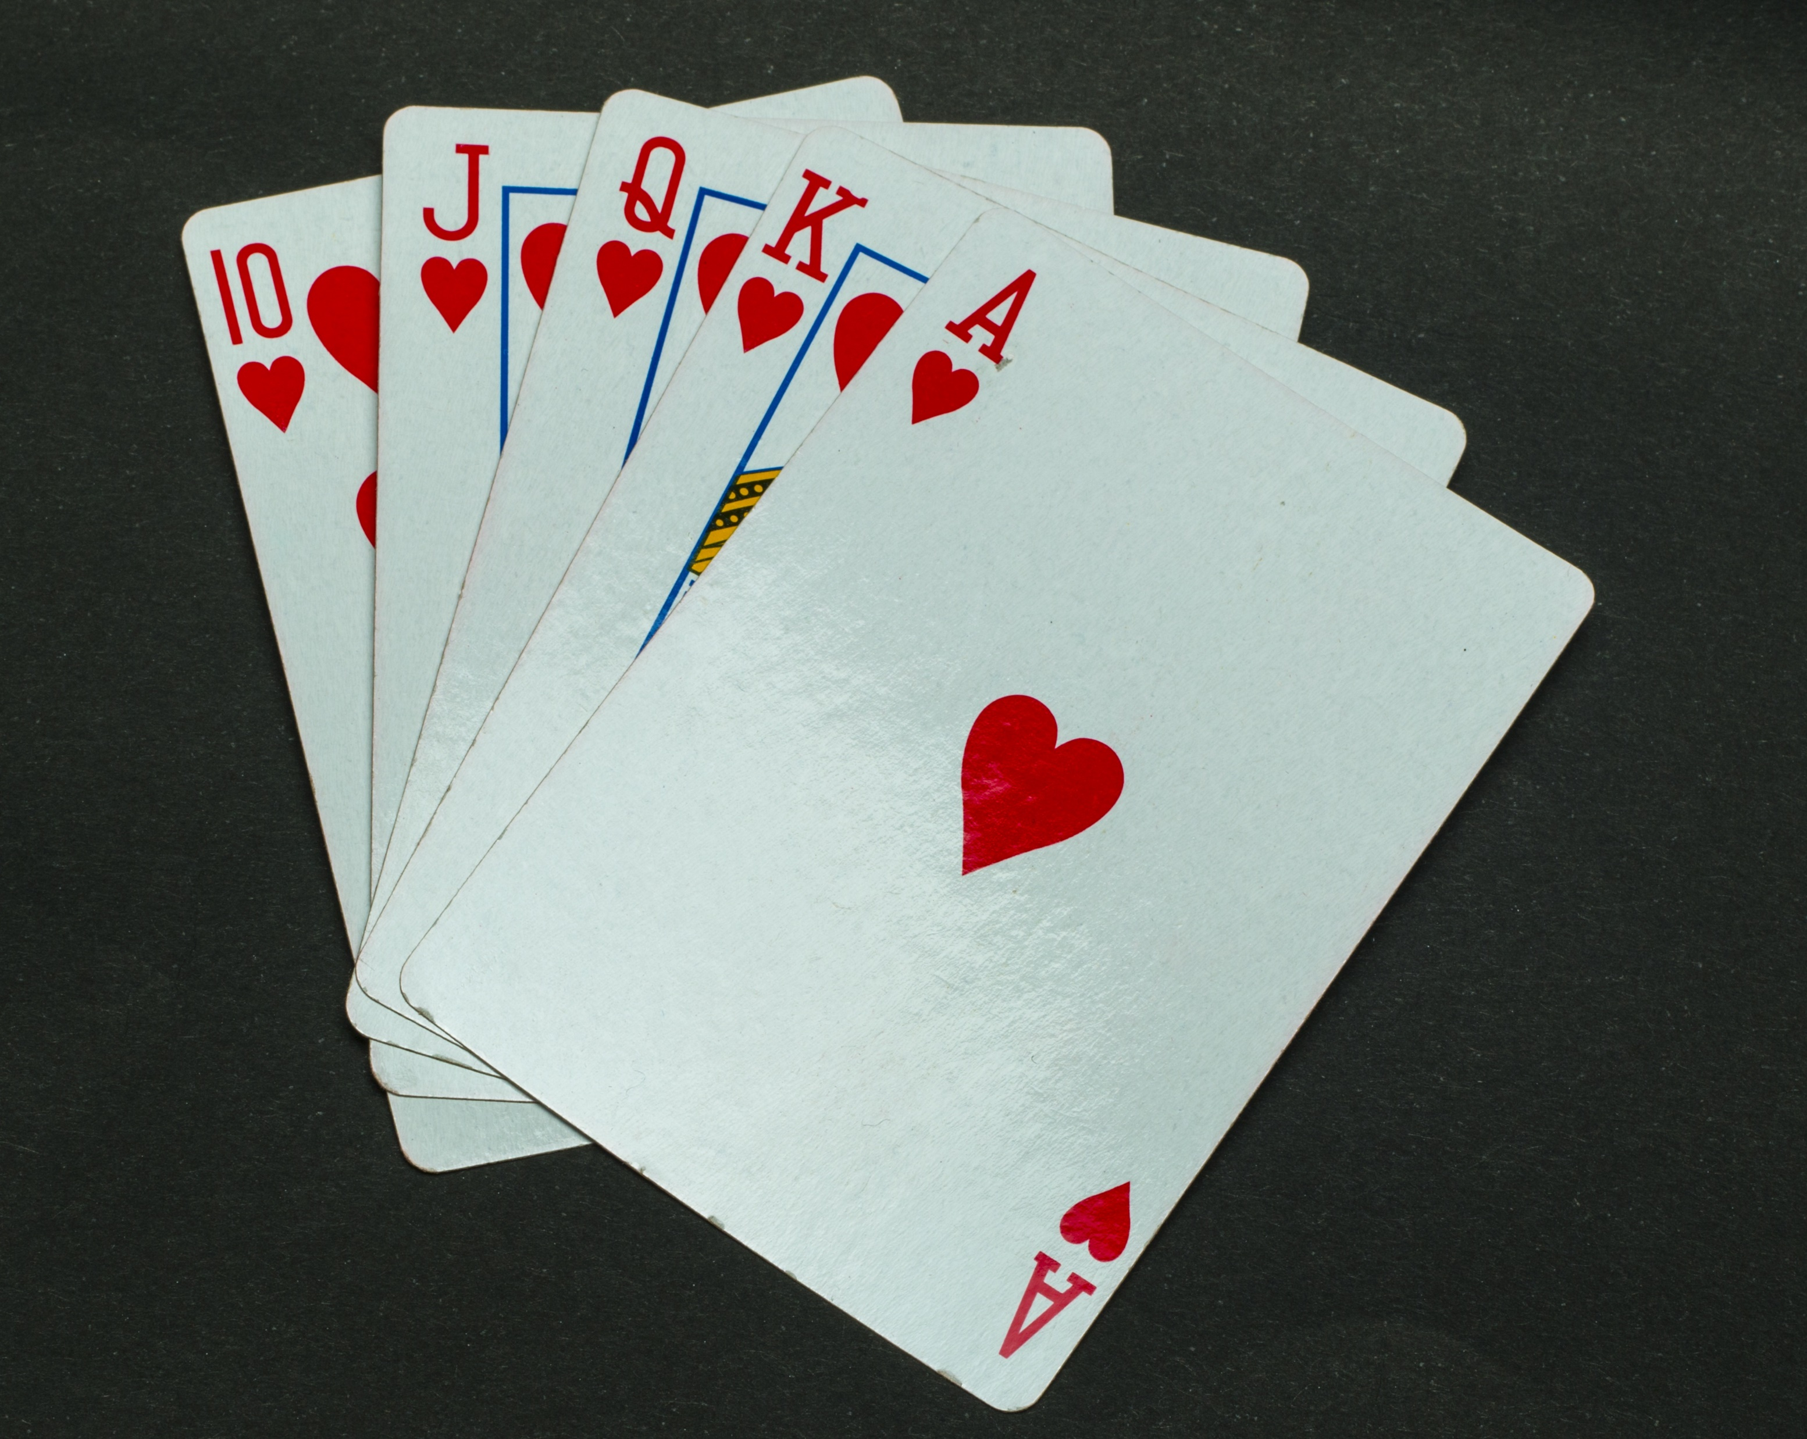
Mrs. Pennington
Insert photo
here
Hello! I am so glad to be teaching another year in preschool. This is my 9th year in preschool and 13th year teaching. I have my Masters in early childhood and a Bachelors degree in elementary education with a kindergarten endorsement.
I am originally from Dickinson but currently live on a ranch with my husband Kyle and our two sons; Kolin and Owen.
Email:
erin.pennington@k12.nd.us
Phone:
575-4275
Coffee
Traveling
Chocolate
Family Time
Playing Cards

Slide 2
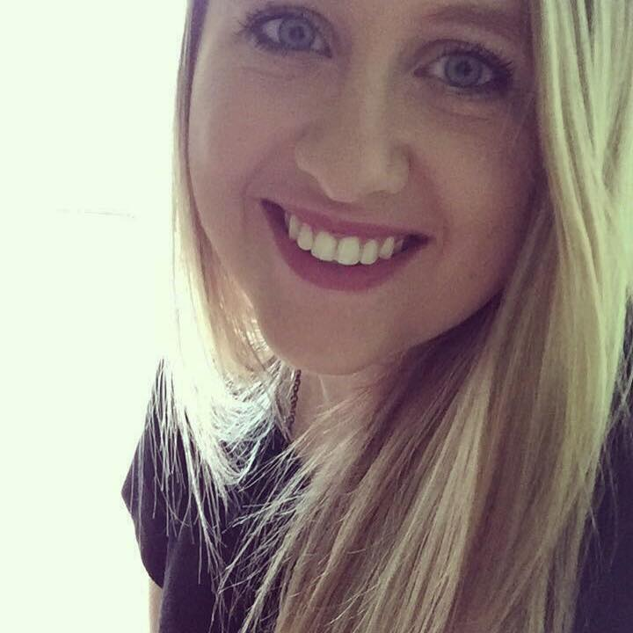
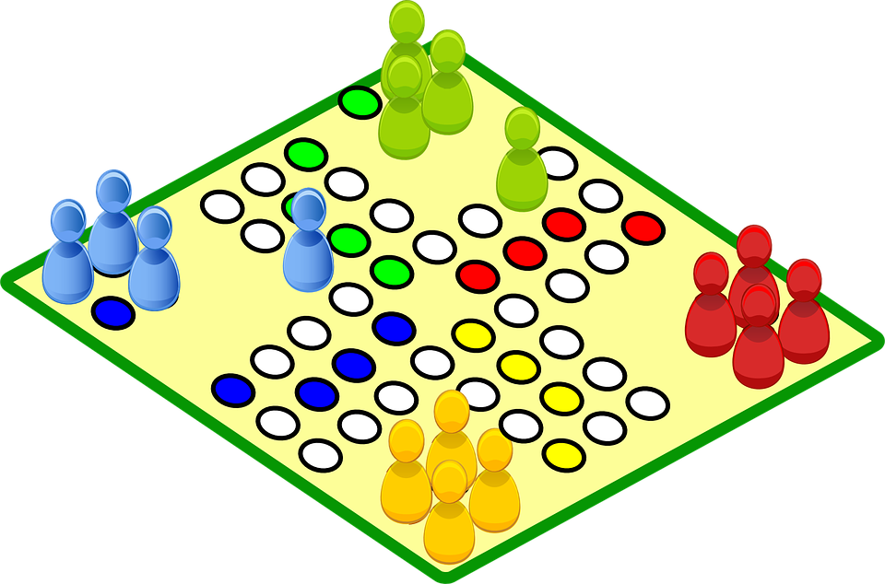
Ms. Lacy
Hello everyone! I am Ms. Lacy. This is my fourth year as the Preschool Para and fifth year being a substitute teacher for the Belfield Public School. I am married to my husband Spencer and we have two kids named Hannah and Logan. We all live out of town with our dog named Hank and our cat named Maple.
Phone:
575-4275
Gardening
Reading
Fall
Family Time
Games
Chocolate

